Slide 1


Green Pace
Security Policy Presentation
Developer: Tyler Primas

Slide 2

OVERVIEW: DEFENSE IN DEPTH
Core security principles:
C/C++ coding standards
Authorization, Authentication, and Auditing Standards
Data encryption Standards
Will help create more secure software and be able to stop vulnerabilities before they become a larger issue

Slide 3
THREATS MATRIX
Each threat has its own threat level which is determined by severity, likelihood, remediation cost, priority, and level
Likely The threat is likely to occur and should be addressed before less likely threats | Priority Will need to be dealt with as soon as possible to keep software safe and secure
Low priority Will need to get to the issue, but does not need to be dealt with right away | Unlikely The threat is unlikely to occur so should be focused on after more likely vulnerabilities are dealt with

Slide 4
10 PRINCIPLES
Validate Input Data
Heed Compiler Warnings
Architect and Design for Security Policies
Keep It Simple
Default Deny
Adhere to the Principle of Least Privilege
Sanitize Data Sent to Other Systems
Practice Defense in Depth
Use Effective Quality Assurance Techniques
Adopt a Secure Coding Standard

Slide 5
CODING STANDARDS
Error Handling – Detect and handle standard library errors
SQL Injection – Sanitize data passed to complex subsystems
Memory protection – Do not access freed memory
Data Value – Ensure that integer conversions do not result in lost or misinterpreted data
Sensitive Information – Never hard code sensitive information
Input/Output – Do not access a closed file
Exceptions – Handle all exceptions
String Correctness – Do not concatenate different type of string literals
Assertions – Use a static assertion to test the value of a constant expression
Data Type – Implement abstract data types using opaque types

Slide 6
ENCRYPTION POLICIES
Encryption at rest
Used to protect data that is stored or at rest on a device or server
Encryption in flight
Used to secure data as it travels over networks or other communication channels
Encryption in use
Allows data to remain encrypted while it is being processed or used by applications or algorithms

Slide 7
TRIPLE-A POLICIES
Authentication
Focuses on verifying the identity of users, devices, or entities attempting to access a system or resource
Authorization
Involves granting appropriate access rights and permissions to authenticated users or entities
Accounting
Involves monitoring and logging user activities and system events to create a record of actions taken within the system

Slide 8
Unit Testing

Slide 9
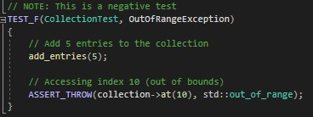
Out of Range Exception

Slide 10
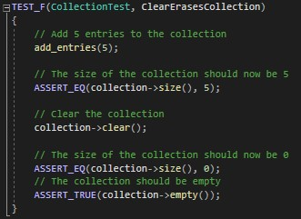
Clear Erases Collection

Slide 11
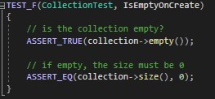
Empty on Create

Slide 12
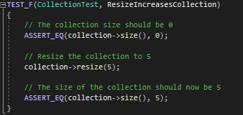
Resize Increases Collection

Slide 13

AUTOMATION SUMMARY

Slide 14
TOOLS
Automation will help to enforce the standards
Most automation will be built into the Design and Build phases
Some external automation tools used for standard types:
Polyspace Bug Finder
Parasoft C/C++ test
Code Sonar
Cppcheck
These tools will be utilized to find any potential issues

Slide 15
RISKS AND BENEFITS
Act now:
Prevent currently known issues
Expensive
Gain trust of users
Prove we value security
Wait:
Give more time to see how big of an issue it is
Potentially more expensive
If attack occurs, lose trust of users
Loss of confidentiality in some cases
Focus on fixing high priority issues first

Slide 16
RECOMMENDATIONS
There may be new undiscovered security issues in the future
Review policies on a regular basis
Ensure relevancy to the goals of the company
Break it down into manageable pieces
Procedures should address more than the Do’s and Don’ts
Create security awareness programs for employees

Slide 17
CONCLUSIONS
Everyone should work as a team to create secure software
Follow standards outlined
Review policies to be sure we are staying up to date
Defense in Depth, encryption policies, and Triple-A policies will help create secure software

Slide 18
REFERENCES
Bellairs, R. (n.d.). Coding Standards Best Practices: How to Use Coding Standards | Perforce Software. Perforce Software. https://www.perforce.com/blog/qac/coding-standards-best-practices-how-use-coding-standards
IT Security Policy - Best Practices Guide | CISO Collective. (2022, December). Fortinet Blog. https://www.fortinet.com/blog/ciso-collective/it-security-policy-best-practices-guide
SEI CERT C Coding Standard - SEI CERT C Coding Standard - Confluence. (2008, March). SEI CERT C Coding Standard - SEI CERT C Coding Standard - Confluence. https://wiki.sei.cmu.edu/confluence/display/c

